Slide 1

CASE STUDY
BLOCKCHAIN AND THE FUTURE OF DIGITAL IDENTITY MANAGEMENT
Sanika Jadhav D11AD-B/21

Slide 2
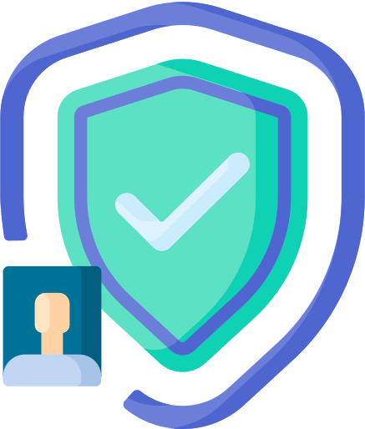

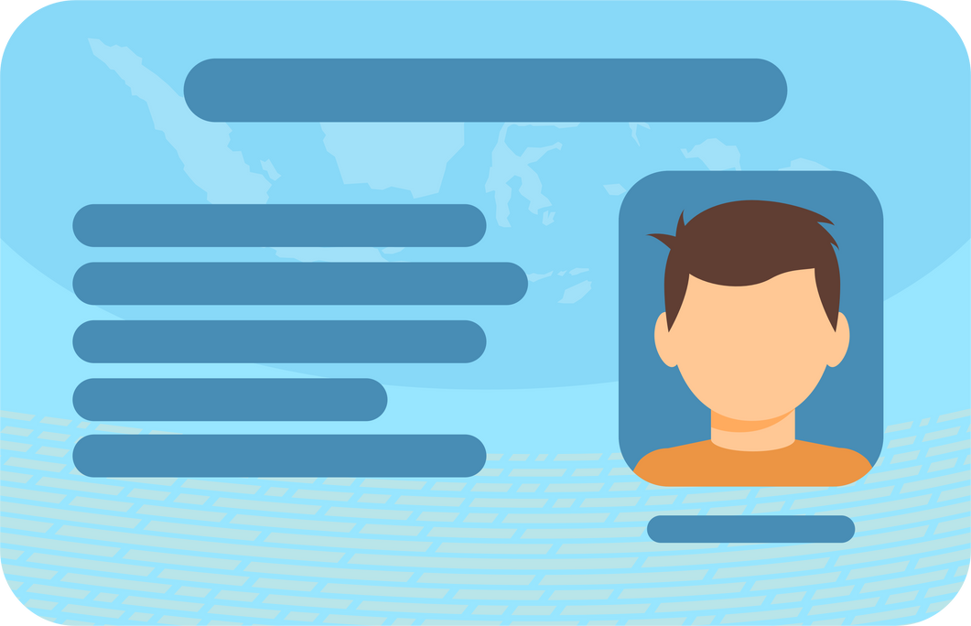
INTRODUCTION
  What is Identity Management ?
Identity Management (IDM) is the framework for managing digital identities, ensuring the right individuals access the right resources.
  Traditional Identity Management Systems (IDMS) are centralized, leading to:
  Single points of failure
  Data breaches and identity theft
  Limited user control

Slide 3
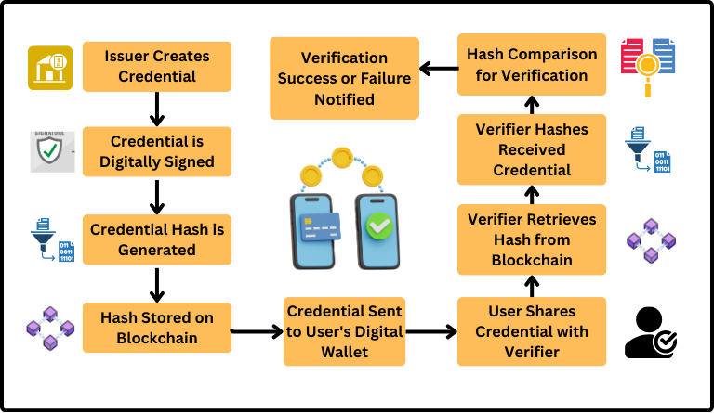
FLOWCHART

Slide 4
UNIVERSITY DIPLOMA ON BLOCKCHAIN
  University Issues Digital Diploma:
University creates a cryptographically signed digital diploma and stores it on the blockchain.
  You Store in Your Digital Wallet:
The diploma is securely stored in your digital wallet.
  Sharing with Employer:
You share the diploma directly from your wallet with the employer.
  Employer Verifies via Blockchain:
The employer verifies the diploma’s authenticity on the blockchain without accessing your personal data.

Slide 5
ADVANTAGES
  User Control: You own your identity, not a centralized entity.
  Improved Security: Cryptographic techniques and decentralization make data breaches harder.
  Privacy: Share only the information you want (e.g., proving your age without revealing your exact birthdate).
  Interoperability: Use the same digital identity across different platforms.
  Auditability: Every transaction is recorded on the blockchain, providing a tamper-proof log.

Slide 6
CHALLENGES & DISAVANTAGES
  Scalability: As blockchain networks grow, handling large volumes of data may become slow or costly.
  Key Recovery: If you lose your private keys, you lose access to your identity (there's no central authority to help).
  Regulatory Issues: Legal frameworks for digital identities are still developing.
  User Adoption: Not everyone is familiar with blockchain, and it might require a steep learning curve.

Slide 7
USE CASES
  Healthcare: Patients manage their own medical records (e.g., COVID vaccination passports).
  Finance: Blockchain can streamline KYC (Know Your Customer) and AML (Anti-Money Laundering) checks.
  Education: Universities issue verifiable diplomas on the blockchain.
  Government: National digital IDs could be stored and verified on a blockchain.
  Social Impact: Blockchain can help empower the unbanked and undocumented individuals by providing them with verifiable identities.

Slide 8
FUTURE SCOPE
  Universal Digital IDs: Movement toward globally accepted, interoperable self-sovereign identities (SSI) that work across borders and platforms.
  Integration with AI & IoT: Smart cities, connected healthcare, and intelligent devices using secure, verifiable identities for people and machines.
  Privacy-Preserving Innovations: Growth of technologies like zero-knowledge proofs (ZKPs) to verify identity without revealing personal data.
  Legal & Regulatory Frameworks: Ongoing development of laws and standards to support decentralized identity adoption (e.g., GDPR-compliant SSI).

Slide 9
CONCLUSION
  Blockchain-based identity systems offer a more secure, private, and user-empowered way of managing identity.
  Challenges remain: scalability, regulation, and user education.
  However, with ongoing research and innovation, blockchain and Self-Sovereign Identity (SSI) have the potential to redefine how we interact with digital systems and trust.

Slide 10
THANK YOU

